Slide 1
6/19/2018
Lambda CI/CD Pipelines
Steffen Gates
Senior Architect, CTAC

Slide 2
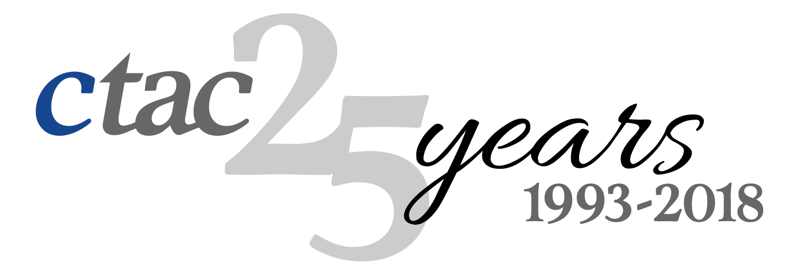

Slide 3
Lambda… Serverless… What?
It’s business logic, in the cloud, without the server
Lambda is AWS’s service for serverless development
Serverless isn’t an “if” question anymore, it’s happening now
It is the glue for AWS services
It is the model for highly scalable, highly available, low cost services

Slide 4
Serverless doesn’t have to be scary
But… it’s scary! No server? What? How do we maintain control?
CRQs
CCBs
Versioning
Release planning
Audits
Release and rollback
Insight
Governance

Slide 5
Automate Everything…
but the decision

Slide 6
What is CI/CD?
Automate workflow from commit, to testing, staging, production
Use of pipelines controls flow
Infrastructure & configuration as code
Reduce bugs, eliminate human error, reduce downtime during deployment
Delegate control of your release process
Reduce busy-work

Slide 7
Why CI/CD for Serverless?
A structured, automated, commit-to-deploy pipeline (for Lambda)
Run automated tests and automated pre-release tasks
Notification hooks
Separation of Dev / Stage / Prod versions
Manual approval of releases
Automatic promotion of versions to production environment on approval

Slide 8
End User
Release Manager
CodeCommit
Checkout
Dev Stage
Prod Stage
Build/Test
Cloud9
S3
Create Change Set
API Gateway
For Development
Execute Change Set
Lambda Dev Alias
Lambda Prod Alias
Approve
Approve
CodePipeline
Promote
CloudFormation Stack
CloudFormation Stack

Slide 9
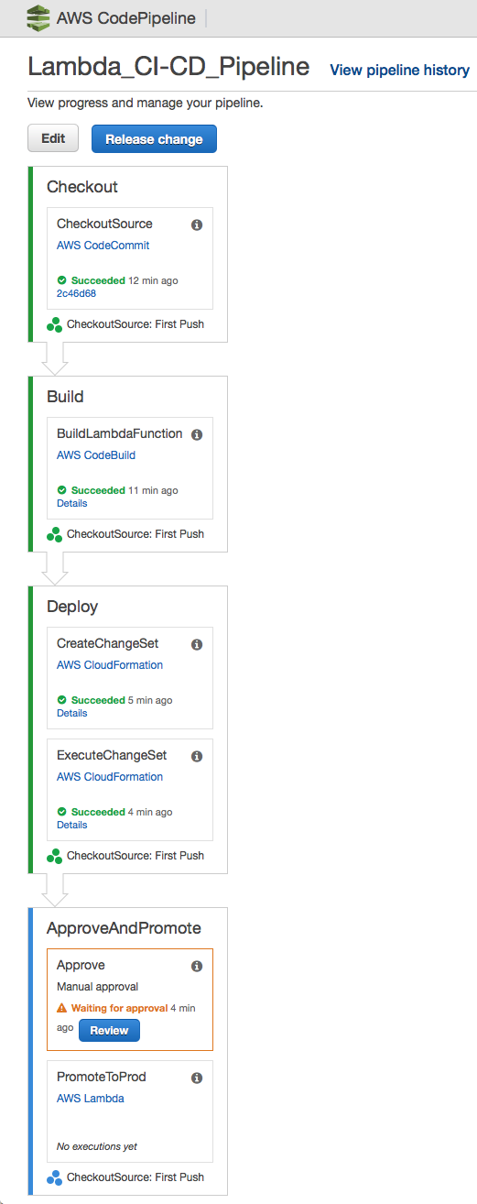
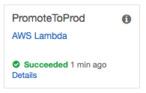
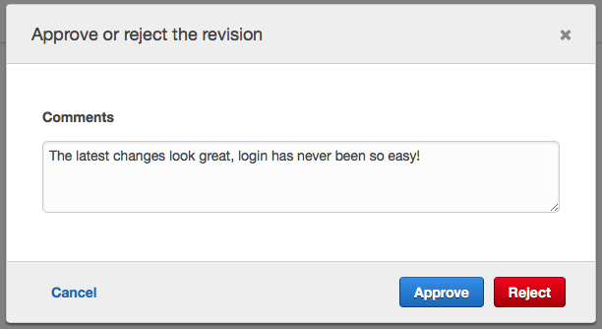
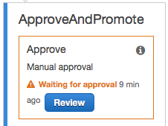
Pipeline Approval Process

Slide 10
Automate Everything…
but the decision

Slide 11
Thank You!
Come visit us and ask us how we can help!
Steffen Gates
Senior Architect at CTAC
info@ctacorp.com
Booth # 419

